Slide 1
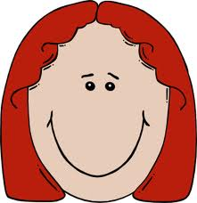
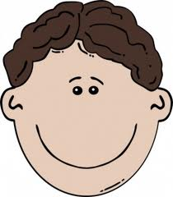
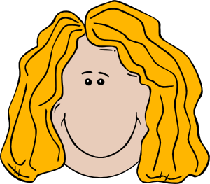
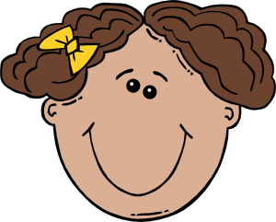
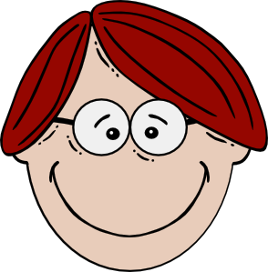
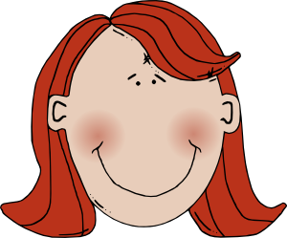
WHAT ARE THEY WEARING?

Slide 2
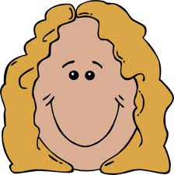
What is Mary wearing?
MARY
Mary is wearing red sandals, white socks, an orange dress and a beautiful necklace.

Slide 3
What is she wearing?
Katy

Slide 4
Ask your pair.
Tom

Slide 5
Jack

Slide 6
Mrs Sike

Slide 7
Daisy

Slide 8
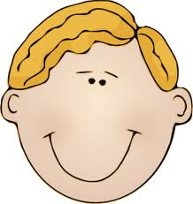
Mickey

Slide 9
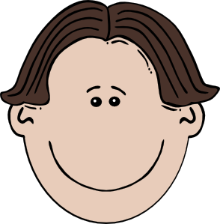
Peter

Slide 10
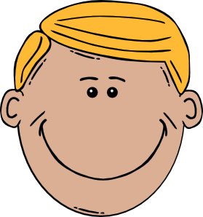
Mr Black

Slide 11
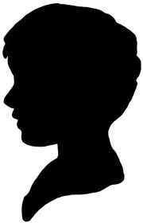
What are you wearing today?
?
?
YOU
?
?

Slide 12
How good is your memory?
What’s his/her name?
He is wearing a dark brown suit, an orange shirt, a brown tie, grey socks, light and dark brown shoes, and glasses.
She is wearing a green and yellow scarf, a denim mini skirt, a jacket and high heel boots.
He is wearing a blue and orange baseball cap, brown boots, a brown sweater and brown trousers with lots of pockets.

Slide 13
It’s your turn.
Describe one of your classmates.
Guess who?

